Slide 1



Exploring the Effect of Personalized Virtual Reality
Serious Game for Stroke Rehabilitation
RVA 2025/2026 - Final Presentation
Ana Rita Guimarães - 124362
David Palricas - 108780

Slide 2
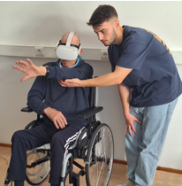

INTRODUCTION
Why this Project?
How does stroke impacts our society?
Why VR for rehabilitation?
2

Slide 3



OBJECTIVES
Create at least 2 VR mini-games
Create the personalisation’s structure
Test with users
5

Slide 4
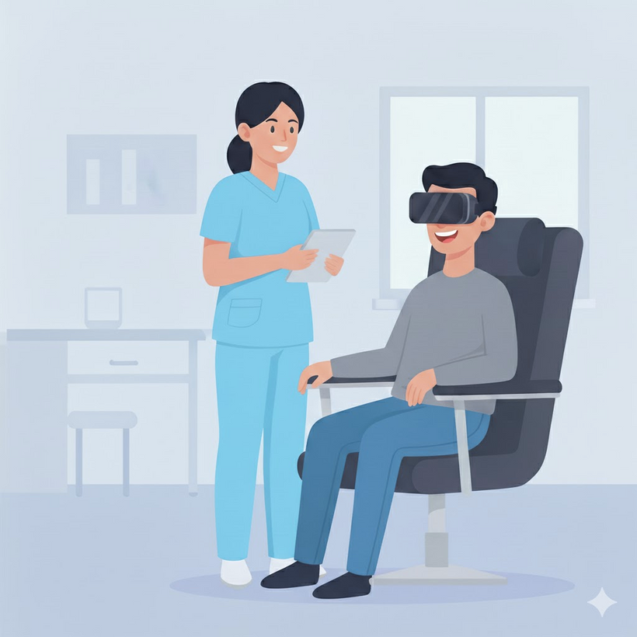
VISION
A functional VR prototype developed for rehabilitation
A new, more motivating and enjoyable form of rehabilitation
Contribute in in VR Rehab Field
4

Slide 5
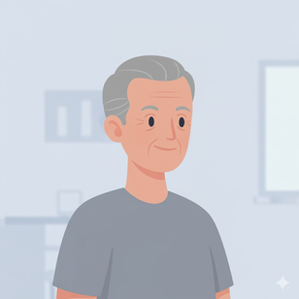

USER STORIES
As a stroke survivor, I want to engage in enjoyable and motivating activities so that I can stay committed to my rehabilitation process.
Manuel
72 years old
Plumber
40 years of experience
Retired
As a healthcare professional, I want to monitor my patients’ progress in real time so that I can make informed adjustments to their therapy plans.
Maria
30 years old
Physiotherapist
Specialized in Stroke Rehabilitation
5 years of experience
5

Slide 6
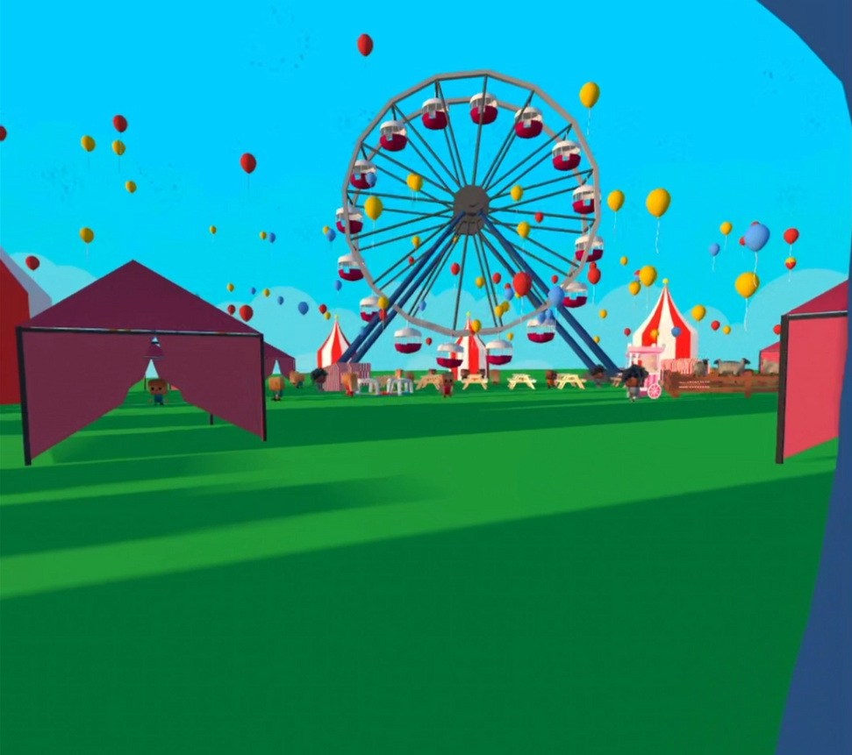
PROTOTYPE ENVIRNOMENT
Country Fair
Cultural resonance
Emotional value
Promoting an engaging environment
6

Slide 7
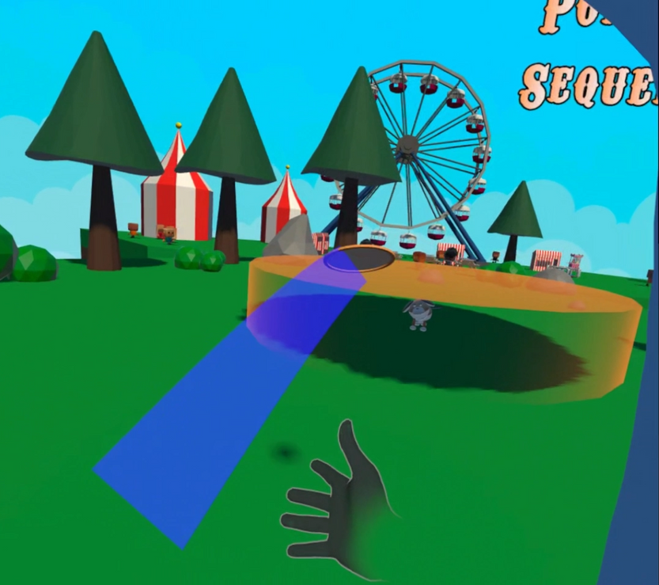
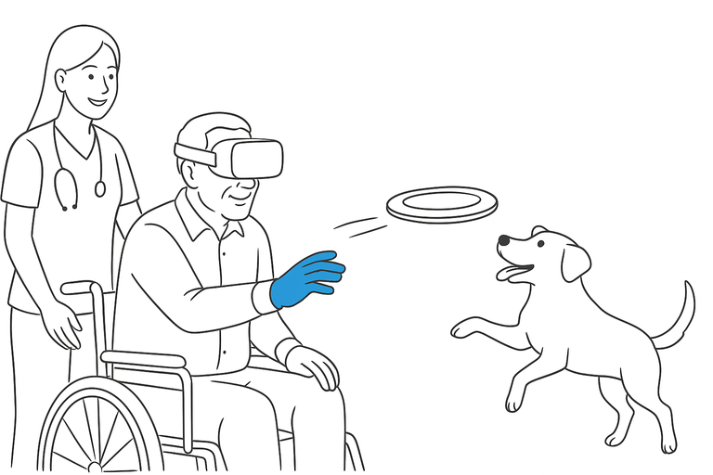
PROTOTYPE DEVELOPED
Frisbee Game
Throw Frisbee and show trajectory
Display the target area
Dog’s behaviour to catch the frisbee and deliver it to the player
Score and streak displayed in the UI
Sound feedback
7

Slide 8
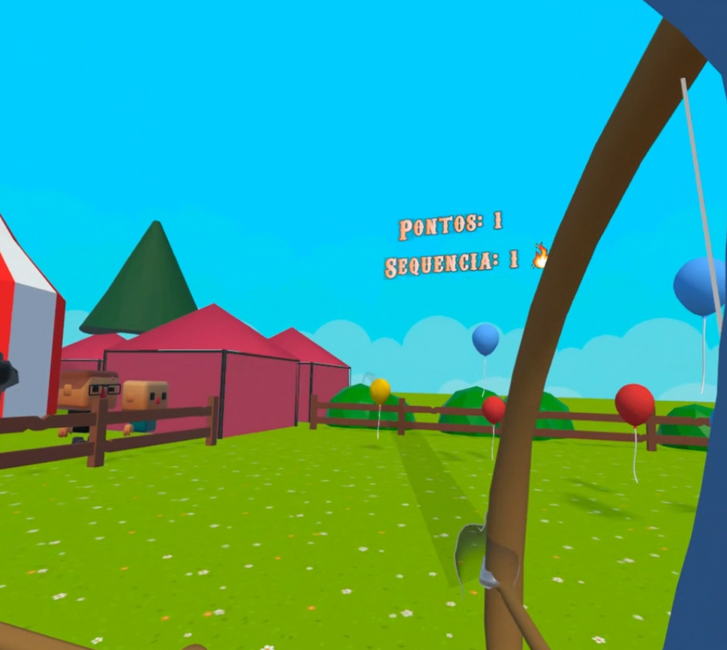
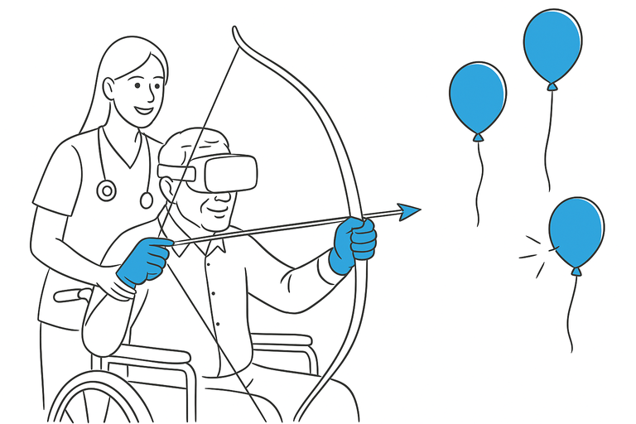
PROTOTYPE DEVELOPED
Archery Game
Bow pull and arrow release
Show arrow trajectory
Balloon interaction and respawn
Score and streak displayed in the UI
Sound feedback
8

Slide 9



TOOLS USED
Software: Unity, Blender and FMOD
Hardware: Oculus Quest 3
Libraries: Meta Interaction SDK, FMOD Unity, DotTween
3D Models:
Balloons, bow and arrow - Rita
Dog, frisbee, trees, bushes and stones - David
Button - Meta
Ferris Wheel and sheep - Poly by Google
Fence - Quaternius
Persons - J-Toastie
Other models - sirkitree
9

Slide 10
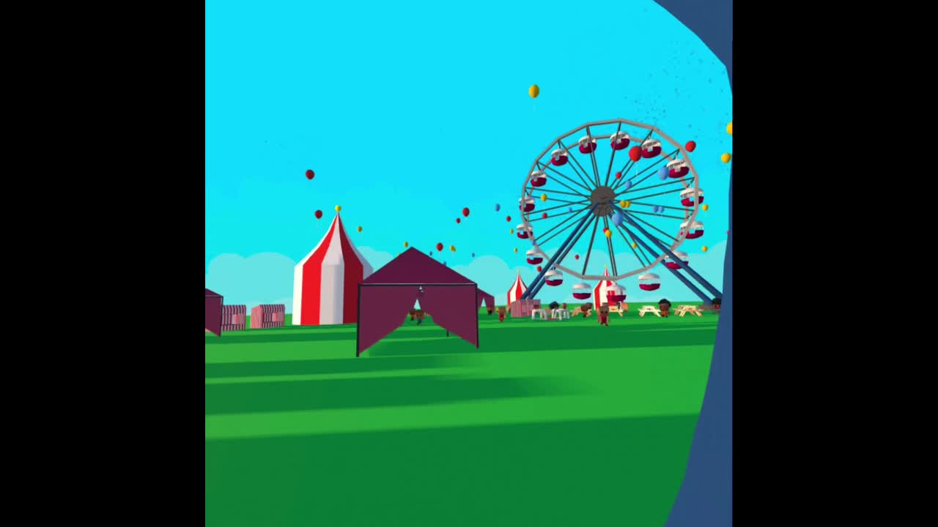
DEMO
10

Slide 11
USER EVALUATION - TASKS
Pessoa 1 | Pessoa 2
12s | 3s | Tarefa 1: Selecionar um mini jogo para jogar
5s | 8s | Tarefa 2: Voltar para a feira
11s | 11s | Tarefa 3: Arrebentar 3 balões no jogo do arco
53s | 37s | Tarefa 4: Marcar 1 ponto no jogo do frisbee
11

Slide 12
USER EVALUATION - FEEDBACK
Overall Experience:
The mini game were fun to play
The users felt they were in a country fair
Liked the sound feedback
Felt that the mini games needed a tutorial
12

Slide 13
USER EVALUATION - FEEDBACK
Frisbee mini-game:
The frisbee curved to much in the direction of the throwing hand.
Instead of going to the user’s exact position, the dog delivered the frisbee directly to the nearest outstretched hand
Archery mini-game:
Balloon Scoring: Considers texture (e.g., metallic) and legend plates, not just color.
The arrow sometimes launches while the string is still being pulled.
13

Slide 14
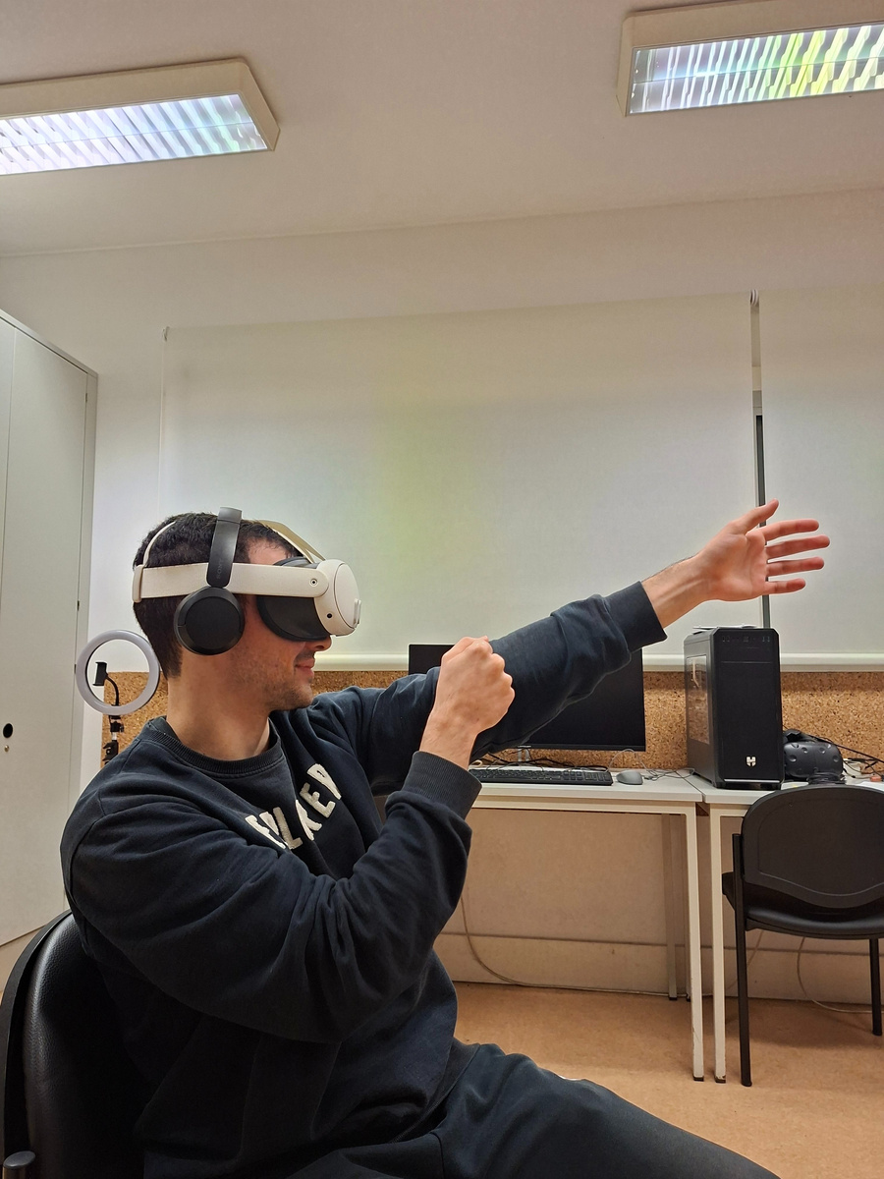
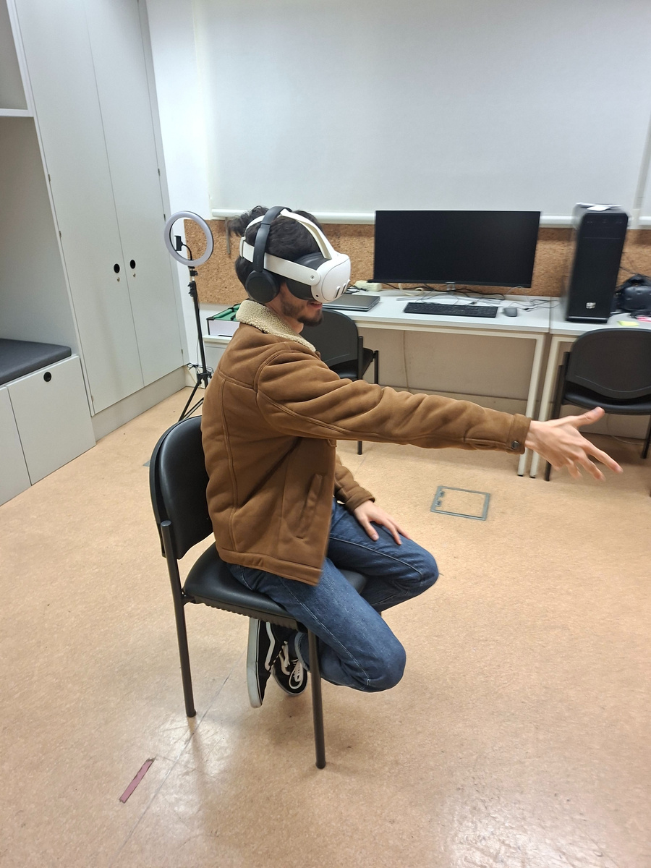
USER EVALUATION - OBSERVATIONS
Users felt amused while playing
1 user struggled to understand how to score a point in the Frisbee mini game
There were no signs of any negative after effect
14

Slide 15
EXPECTATIONS VS REALITY
Expectations:
Mini games would be simple to implement
No bugs at final presentation
We would be able to test with several users
No major technical issues
Reality:
Getting the physics right took longer than expected
Minor bugs remained
Tested with some users
Overall no major difficulties were encountered
15

Slide 16
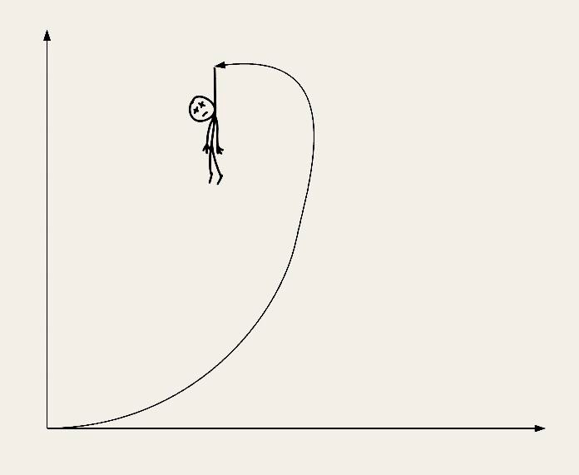
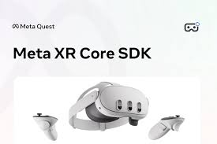
MAIN DIFFICULTIES
Learn VR development in unity
Hand tracking accuracy and stability
Implementing and fine-tuning physics
Debbuging and testing in VR
Headset management
Find information in Meta SDK Documentation
16

Slide 17
FUTURE WORK
Add a tutorial
Create a system that adapts to user's performance
Improve physics
Improve gameplay
Add more feedback
17

Slide 18
Thank you!
Ana Rita Guimarães - 50%
David Palricas - 50%

